Slide 1

Microelectronics device and processes
微电子工艺基础

Slide 2
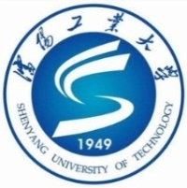
Properties of Semiconductor Materials and Chemicals
Introduction
Semiconductor materials possess electrical, chemical, and physical properties that allow the unique functions of semiconductor devices and circuits. In this chapter, these properties are examined along with their basics of atoms, electrical classification of solids, and intrinsic and doped semiconductors.
The fabrication of a semiconductor device requires the addition of various layers that perform specific functions in the devices. These materials have specific properties and must be added to the wafer through carefully selected and controlled physical and chemical processes.
Notes:
半导体材料具有电，化学和物理特性，这些特性使半导体器件和电路具有独特的功能。 在本章中，将对这些特性以及它们的原子基础，固体的电分类以及本征和掺杂半导体进行检查。
半导体器件的制造需要添加在器件中执行特定功能的各种层。 这些材料具有特定的特性，必须通过仔细选择和控制的物理和化学过程将其添加到晶圆中。
本章讨论并说明了气体，酸，碱和溶剂的基本特性。

Slide 3
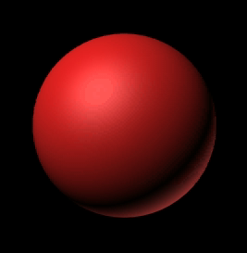
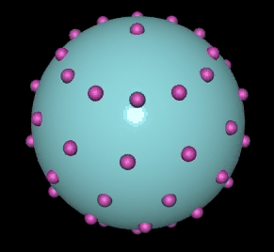
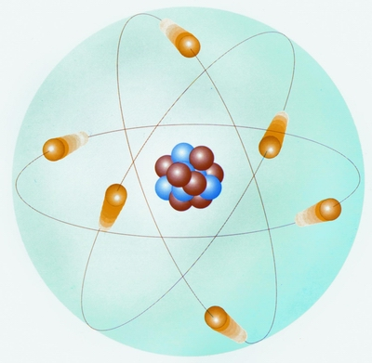
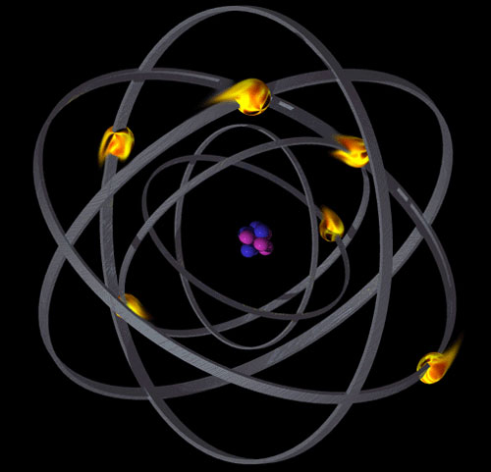
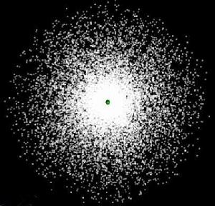
Properties of Semiconductor Materials and Chemicals
Dalton Model (1803）
Thomson model (1904)
Rutherford Model (1911)
Bohr Model (1913)
Electronic Cloud Model (1935)
Atomic Structure
Notes:
Dalton Model (1803）：提出物质是由原子组成，原子不能被创造，也不能被毁灭，在化学变化中不可再分割，在化学反应中保持本性不变。
Thomson model (1904)：汤姆生发现原子中存在电子，并用实验方法测出电子的质量。“葡萄干-面包式”：正电荷均匀地分布在原子之中，电子则散布在正电荷之中。
Rutherford Model (1911)：认为原子的质量几乎全部集中在直径很小的核心区域，叫原子核，电子在原子核外绕核作轨道运动。原子核带正电，电子带负电。
Bohr Model (1913)：在卢瑟福模型的基础上，他提出了电子在核外的量子化轨道，解决了原子结构的稳定性问题，描绘出了完整而令人信服原子结构学说
Electronic Cloud Model (1935)：根据不确定性原理，电子绕核运动形成一个带负电荷的云团，对于具有波粒二象性的微观粒子在一个确定时刻其空间坐标与动量不能同时测准。
材料的性质是由其微观结构决定的，早在200年前，学者们就已经提出这样的一个命题“把物体无限的切割下去，最后到达一个什么样的程度，它就不能再分割了呢”
物质都是由分子原子构成的，我们将原子再分割就是内部的原子核，大多数原子核都是由质子和中子构成，质子和中子都是由夸克构成的

Slide 4
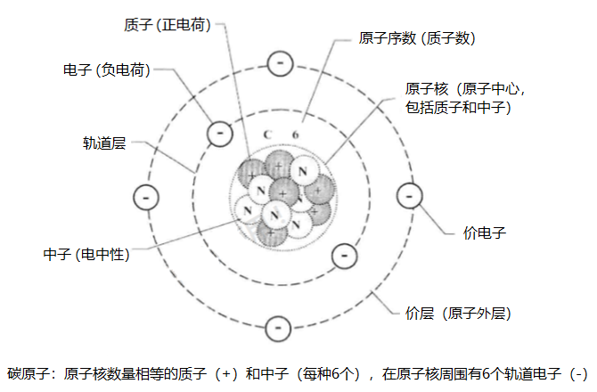
Properties of Semiconductor Materials and Chemicals
Atomic structure diagram (carbon atom)
Notes:
原子级的能力单位是电子伏特，代表一个电子从低电势处移动到高电势处所获得的动能。这个也就是能级的跃迁了，1.6x10⁻¹⁹J
原子的最外层电子就是价电子，对原子的理化性质产生显著影响

Slide 5
Properties of Semiconductor Materials and Chemicals
The Periodic Table of the Elements
Notes:
俄国化学家门捷列夫(Dmitri Mendeleev)于1869年总结发表此周期表，在周期表中，元素是以元素的原子序数排列，最小的排行最先。表中一横行称为一个周期，一列称为一个族，元素周期表揭示了化学元素之间的内在联系，使其构成了一个完整的体系，成为化学发展史上的重要里程碑之一。
截止到2016年表上有118号元素、
同主族元素从上到下原子序数逐渐增大，电子层数逐渐增多，原子半径逐渐增大，得电子能力逐渐减小，失电子能力逐渐增大，元素金属性逐渐增大，非金属性逐渐减小，气态氢化物稳定性逐渐减小。
副族元素（用 “B”表示）：凡 最 后 1个电子填入（n - 1 ) d 或 （n - 2 ) f 亚层上的元素都 属于副族元素，也称为过渡元素（镧系和锕系称为内过渡元素）

Slide 6


Properties of Semiconductor Materials and Chemicals
The Periodic Table of the Elements
I A
I A ：
One valence electrons
Unstable
Very active， explosibility
Not used
II A：
Two valence electrons
Less stable
Quite active
Not used
II A

Slide 7
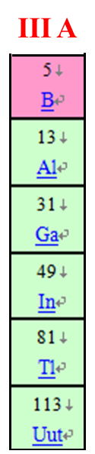
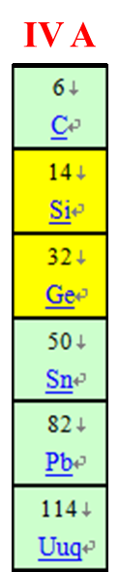
Properties of Semiconductor Materials and Chemicals
The Periodic Table of the Elements
III A：
Three valence electrons
Impurity element （mainly B）
Common interconnect conductive materials （Al）
IV A：
Four valence electrons
Semiconductor
Covalent bonds

Slide 8
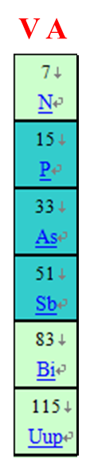
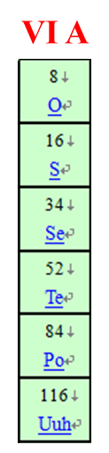
Properties of Semiconductor Materials and Chemicals
The Periodic Table of the Elements
V A：
Five valence electrons
Impurity element (mainly P and As)
VI A：
Six valence electrons

Slide 9
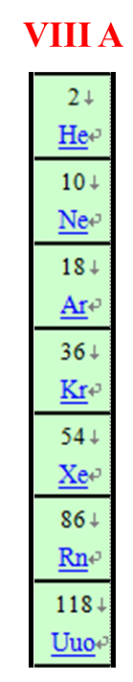
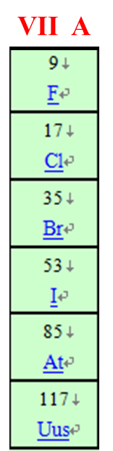
Properties of Semiconductor Materials and Chemicals
The Periodic Table of the Elements
VII A：
Seven valence electrons
Corrosive
Very active
Ionic bonds
Used as etching and cleaning compounds
VIII A：
Eight valence electrons
Stable，inactive
Inert gas

Slide 10

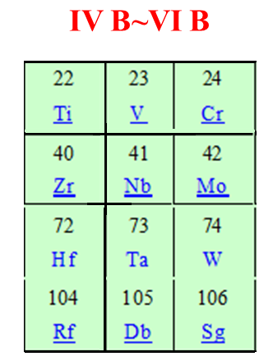
Properties of Semiconductor Materials and Chemicals
The Periodic Table of the Elements
I B：
Best Metal Conductor
Copper is replacing the position of Al interconnect conductor material
IV B~VI B：
High melting point metals
Commonly used to improve metallization （Ti、W、Mo、Ta and Cr）.They react well with Si to form stable compounds with excellent electrical properties

Slide 11
Properties of Semiconductor Materials and Chemicals
The Periodic Table of the common elements
ⅡA ⅢA ⅣA ⅤA ⅥA
2nd cycle B C N
3rd cycle Al Si P S
4th cycle Zn Ga Ge As Se
5th cycle Cd In

Slide 12
Properties of Semiconductor Materials and Chemicals
Elements of Si IC Chip
Semiconductor（substrate and active region）：Single crystal Silicon
Impurity（N-type and P-type）：
P (As)、B
Conductor（electrode and lead wire）：
Al、W（ Cu 、Ti）、poly-Si
Insulator （gate oxide、 multilayer interconnection dielectrics ）：SiO₂、Si₃N₄

Slide 13
Properties of Semiconductor Materials and Chemicals
Electrical conduction
Definition：Semiconductor refers to a material whose conductivity is between a conductor and an insulator at room temperature.
Conductivity：the property of materials to conduct electricity. Conducting ability is also measured by the reciprocal of the conductivity, which is resistivity.
C=1/ ρ
Conductor ： ρ＜10⁻⁴Ωcm， ρ_{Cu}=10⁻⁶Ωcm
Semiconductor ：10⁻³Ωcm＜ρ＜10⁸Ωcm， ρ_{Ge}=0.2Ωcm
Insulator ：ρ＞10⁸Ωcm
Notes:
半导体是指在常温下导电性能介于导体与绝缘体之间的材料。

Slide 14
Properties of Semiconductor Materials and Chemicals
Semiconductor material classification
Element
Photoelectric
Inorganic
Thermoelectric
Composition
Compound
Function & application
Organic
Microwave
Gas sensitive
Single crystalline
Microelectronics
Crystal
Structure
Polycrystalline
Amorphous

Slide 15
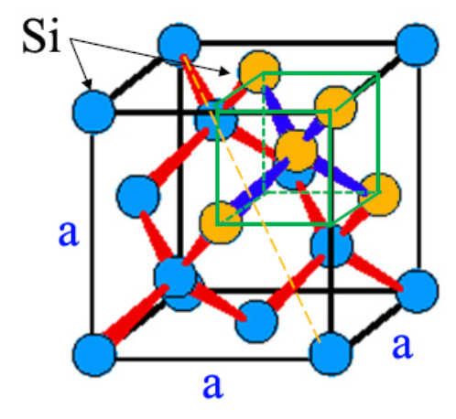
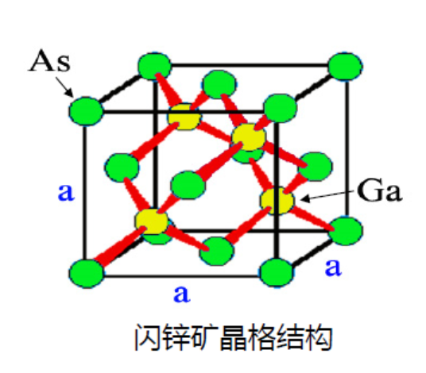
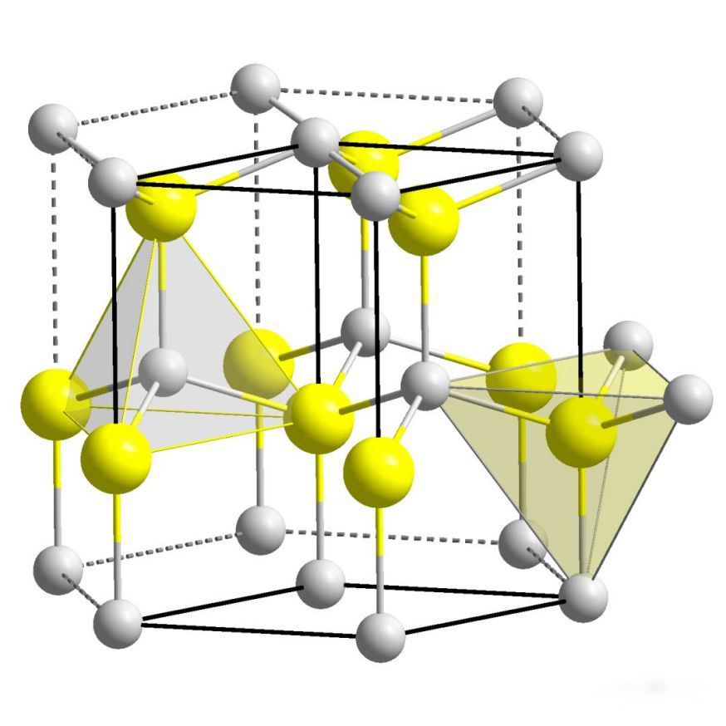
Properties of Semiconductor Materials and Chemicals
Semiconductor material crystal structure
Diamond crystal structures
（Si、Ge、 C、 Sn）
Zincblende structure
(GaAs、InSb、ZnS)
Wurtzite structure
(InN，GaN，ZnO)
Notes:
金刚石结构：由同一种元素的原子按正四面体结构构成的立方点阵为金刚石结构
闪锌矿结构：由两种元素的原子按正四面体结构构成的立方系晶体点阵称为闪锌矿结构
纤锌矿结构：是闪锌矿加热到1020度时六角对称型变体，具有六角对称性

Slide 16
Properties of Semiconductor Materials and Chemicals
Intrinsic semiconductor: pure single crystal semiconductors, that is, semiconductors with complete structure without any impurities. At absolute zero, an intrinsic semiconductor is equivalent to an insulator. At room temperature, some valence electrons break away from covalent bonds and form electron-hole pairs.
The purity of semiconductor materials for manufacturing semiconductor devices should reach 99.999999%, which is often called "nine nines".
Covalent bond structure of silicon crystal
Energy band structure diagram
E
Empty band
Empty band
Conduction band
E_{g}
Forbidden band
T=0
The empty band with the lowest energy —conduction band
The full band with the highest energy—valence band
Energy difference between conduction band bottom and valence band top — band gap
Full band
Valence band
Full band
E_{c}—Conduction band bottom
E_{v}— Valence band top
Notes:
如果带隙的跨度很大，也就是说电子从价带跃迁到导带很困难，那么这种材料就是绝缘体
如果导带和价带重合了，电子可以随便溜达，就是导体
而半导体呢其带隙的宽度位于绝缘体和导体之间，硅的禁带宽度为1.11ev。
对常见的半导体,起作用的往往是导带底附近的电子和价带顶附近的空穴,所以主要关注带底附近和价带顶附近的能带结构.
纯净的单晶半导体称为本征半导体，即不含任何杂质，结构完整的半导体。绝对零度下，本征半导体相当于绝缘体；室温下，一部分价电子挣脱共价键束缚，形成电子-空穴对。
制造半导体器件的半导体材料的纯度要达到99.9999999%，常称为“九个9”
能量最低的空带—conduction band
能量最高的满带—价带
导带底与价带顶能量之差—带隙
（禁带宽度）

Slide 17

Properties of Semiconductor Materials and Chemicals
Schematic diagram of pure silicon conduction under intrinsic excitation
Electrons in covalent bonds
are called bound electrons
Free electrons move
directionally
to form electron flow
Electrons that break away
from the bondage of nuclei
are called free electrons.
The vacancies left in the
valence band are called holes
外电场E
+4
+4
+4
Conduction band
The directional movement of
bound electrons to fill
holes forms a hole flow
+4
+4
+4
E_{g}
Valence band
+4
+4
+4
Notes:
这里我们将能带理论与共价键结构的本征半导体结合起来看看其导电的过程。
本证激发半导体虽然具备了导电的能力，但导电能力很差

Slide 18
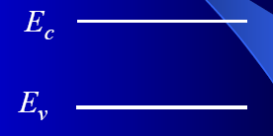
Properties of Semiconductor Materials and Chemicals
Doping: a certain amount of different types of impurities are doped into intrinsic semiconductors, and the effective control of resistivity and minority carrier lifetime is realized by accurately controlling their quantity and spatial distribution, so as to artificially change the electrical properties of semiconductors, such as n-type semiconductors and p-type semiconductors.
Intrinsic semiconductor: no energy level in band gap
Influence of impurities and defects on energy band structure
Introducing impurity or defect energy levels into the band gap of a semiconductor:
Shallow level and deep level -- optical and electrical properties
Notes:
半导体的掺杂：在纯净的半导体(本征半导体)中掺入一定量不同类型的杂质，并通过对其数量和在空间的分布精确地控制，实现对电阻率和少子寿命的有效控制，从而人为地改变半导体的电学性质，如n型半导体和p型半导体。

Slide 19
Properties of Semiconductor Materials and Chemicals
In pure single crystal silicon, a small amount of pentavalent impurity elements, such as P, As and Sb, are added, so that some silicon atoms in the original lattice are replaced by pentavalent impurity atoms to form n-type semiconductors. P-type semiconductors are formed by adding trivalent impurity elements such as B, Ga and In into pure monocrystalline silicon.
N-type semiconductor structure
P-type semiconductor structure

Slide 20
Properties of Semiconductor Materials and Chemicals
Doped semiconductors
The doped material displays two unique properties that are the basis of solid-state electronics.
The two properties are
Precise resistivity control through doping
Electron and hole conduction
Resistivity of doped semiconductors
The doping level is related to the resistivity of materials.
The electrons and holes can in the materials are called carriers.
Carrier Mobility:
The speed of carrier movement is called the carrier mobility.
Holes have a lower mobility than electrons. This factor is an important consideration in selecting a particular semiconducting material for a circuit.

Slide 21
Properties of Semiconductor Materials and Chemicals
History of semiconductor materials
First generation of Semiconductors: element semiconductors (represented by Si and Ge), with larger wafer size (8 ~ 12inch) and smaller characteristic linewidth. SOI, GeSi, strained silicon and high k gate media are used;
Second generation semiconductors: Compound Semiconductors (represented by GaAs and InP), which can make ultra-high speed, low power consumption, low noise devices and circuits, optoelectronic devices and integration；
Third generation of Semiconductors: wide band gap semiconductors (represented by GaN, SiC, ZnO, diamond, etc.), which can make semiconductor microelectronic devices and circuits with high frequency, high power, high temperature resistance and radiation resistance;
New semiconductors: represented by diluted magnetic semiconductors and low dimensional semiconductors, they develop from three-dimensional bulk materials to thin films, two-dimensional superlattice quantum wells, one-dimensional quantum wires and zero dimensional quantum dots.
Notes:
第一代半导体:元素半导体(以Si和Ge为代表)，晶圆尺寸越来越大(8~12inch) 、特征线宽越来越小，以SOI、GeSi、Strain Silicon，high K栅介质；
第二代半导体:化合物半导体(以GaAs，InP等为代表)，可制作超高速、低功耗、低噪音器件和电路，光电子器件和光电集成 ；
第三代半导体:宽禁带半导体(以GaN，SiC，ZnO，金刚石等为代表)，可制作高频大功率、耐高温、抗辐照半导体微电子器件和电路；
新型半导体：以稀磁半导体，低维半导体等为代表，由三维体材料向薄膜、两维超晶格量子阱、一维量子线和零维量子点材料方向发展；

Slide 22
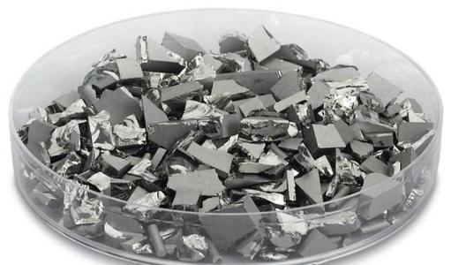
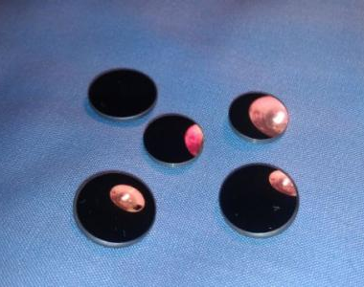
Properties of Semiconductor Materials and Chemicals
Element semiconductor materials
Ge
1871，Russian scientist Mendeleev predicted that there was a "Silicon like" element between Si and Sn in the periodic table of elements.
1886, German scientist Winkler first isolated Ge from silver sulfur germanium ore and named it Ge in memory of his motherland.
Ge is an early model material for semiconductor research. In the 1950s, Ge was the main semiconductor material
Ge has a narrow band gap, stable working temperature and limited resources. At present, Ge electronic devices account for less than 10% of the total, mainly turning to infrared optics.
Notes:
Sn锡 锗（ Ge ）
1871年，俄国科学家门捷列夫寓言，元素周期表Si和Sn之间存在着一个“类硅”的元素。
1886年，德国科学家温克莱尔首先从银硫锗矿中分离出Ge，并将其命名为Ge（Germanium）以纪念他的祖国。
Ge是半导体研究的早期样板材料，在20世纪50年代，Ge是主要的半导体电子材料
Ge的禁带较窄，器件稳定工作温度远不如硅器件高，加之资源有限，目前，Ge电子器件不到总量的10%，主要转向红外光学等方面。

Slide 23
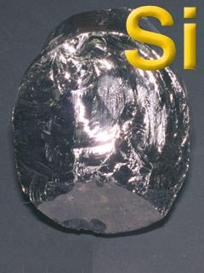
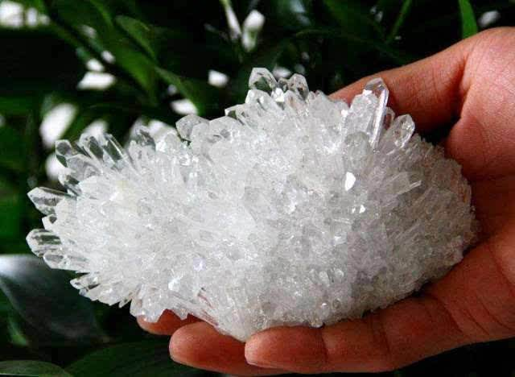
Properties of Semiconductor Materials and Chemicals
Element semiconductor materials
Si
Steel gray，density 2.4 g／cm3， melting point 1420℃，boiling point 2355℃. Crystalline silicon is an atomic crystal, hard and shiny, with semiconductor properties；
Large band gap (1.12eV) and wide working temperature range；
1823, Swedish chemist Berzelius J.J. reduced silicon tetrafluoride with K or coheated with metal K and potassium fluorosilicate to produce pure elemental silicon powder for the first time;
1854， S.C. Deville produced crystalline silicon by electrolysis of mixed chloride molten salt;
Silicon is widely distributed in nature. The earth's crust contains about 26.3%. In nature, there is no free silicon, mainly in the form of silica and silicate;
Notes:
晶体硅为钢灰色，密度2.4 g／cm3，熔点1420℃，沸点2355℃，晶体硅属于原子晶体，硬而有光泽，有半导体性质；
较大的禁带宽度（1.12eV），较宽工作温度范围；
1823年，瑞典化学家贝采里乌斯(Berzelius J.J.)用金属钾还原四氟化硅或用金属钾与氟硅酸钾共热，首次制得较纯的粉状单质硅；
1854年，法国人德维尔（S.C.Deville）用混合物氯化物熔盐电解法制得晶体硅；
硅在自然界分布极广，地壳中约含26.3％，在自然界中是没有游离态的硅，主要以二氧化硅和硅酸盐的形式存在；
硅的分布广泛也是其成为主要半导体材料的原因

Slide 24
Properties of Semiconductor Materials and Chemicals
Stable chemical properties at room temperature and only reacts with strong alkali, hydrogen fluoride and fluorine gas
①Si+2F₂=SiF₄
②Si+4HF=SiF₄ ↑+2H₂↑
③Si+ 2NaOH + H₂O = Na₂SiO₃ +2H₂↑
Active at high temperature
Si + O₂ SiO₂
Application of SiO2 in semiconductor devices
Masking the diffusion of impurities；
Surface protection and passivation of devices；
Insulating isolation layer for devices；
Insulating gate materials used as MOS devices, etc；
Notes:
SiO₂在半导体器件中的作用：
对杂质扩散起掩蔽作用；
对器件的表面保护和钝化作用；
用于器件的绝缘隔离层；
用作MOS器件的绝缘栅材料等；

Slide 25
Properties of Semiconductor Materials and Chemicals
Compound semiconductor: crystalline inorganic compound semiconductor, that is, the compound formed by two or more elements with a determined atomic ratio, and has certain semiconductor properties such as band gap width and energy band structure.
Compound semiconductors include crystalline inorganic compounds and their solid solutions, amorphous inorganic compounds, organic compounds and oxide semiconductors
Compound semiconductors can be divided into binary compound semiconductors, such as GaAs and InSb; Ternary compound semiconductors, such as InGaAs, GaAsP
Common III-V compound semiconductors
Compound | Structure | Eg | Transition
GaAs | zincblende | 1.42 | direct
GaP | zincblende | 2.27 | indirect
GaN | Wurtzite | 3.4 | indirect
InAs | zincblende | 0.35 | direct
InP | zincblende | 1.35 | direct
InN | Wurtzite | 2.05
AlN | Wurtzite | 6.24
Notes:
直接带隙半导体材料就是导带最小值（导带底）和价带最大值（价带顶）在k空间中处于同一位置的半导体。电子要跃迁到导带上产生导电的电子和空穴（形成半满能带）只需要吸收能量
间接带隙半导体材料（如Si、Ge）导带最小值（导带底）和价带最大值在k空间中不同位置。形成半满能带不只需要吸收能量，还要改变动量
化合物半导体：指晶态无机化合物半导体，即是指由两种或两种以上元素以确定的原子配比形成的化合物，并具有确定的禁带宽度和能带结构等半导体性质。
化合物半导体包括晶态无机化合物(如III-V族、II-VI族化合物半导体)及其固溶体、非晶态无机化合物(如玻璃半导体)、有机化合物(如有机半导体)和氧化物半导体等。
化合物半导体可分为：二元化合物半导体，如砷化镓(GaAs)、锑化铟（InSb）；三元化合物半导体，

Slide 26
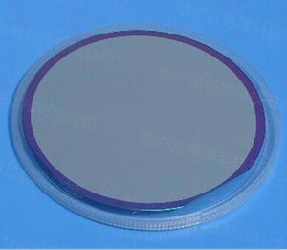
Properties of Semiconductor Materials and Chemicals
GaN，hexagonal wurtzite structure；
Strong atomic bond, high thermal conductivity, high hardness, good chemical stability (hardly corroded by any acid), strong radiation resistance, etc;；
The research and application of GaN is the frontier and hotspot of semiconductor research in the world. It is a new semiconductor material for the development of microelectronic devices and optoelectronic devices；
GaN is a wide band gap (2.3 ~ 6.2eV) compound semiconductor material and can cover the spectral range of red, yellow, green, blue, violet and ultraviolet, which can not be achieved by any other semiconductor material so far.
2014， Yoshiro akazaki of Japan and Takeji Nakamura of Amano won the Nobel Prize in physics for the invention of GaN Blue LED.
Notes:
，大气压力下，GaN晶体为六方纤锌矿结构；
具有强原子键、高热导率、高硬度、化学稳定性好（几乎不被任何酸腐蚀）、抗辐射能力强等性质；
GaN材料的研究与应用是目前全球半导体研究的前沿和热点，是研制微电子器件、光电子器件的新型半导体材料，是第三代半导体材料；
GaN为宽带隙化合物半导体材料，有很高的禁带宽度（2.3～6.2eV)，可以覆盖红、黄、绿、蓝、紫和紫外光谱范围 ，是到目前为止其它任何半导体材料都无法达到的
2014年，日本的赤崎勇、天野浩和的中村修二因发明GaN蓝光LED而获的当年的诺贝尔物理奖；

Slide 27
Properties of Semiconductor
Comparison of GaN with other semiconductor materials
Characteristics | Unit | Semiconductor
 |  | Si | GaAs | InP | SiC | GaN
Eg | eV | 1.1 | 1.42 | 1.35 | 2.3 | 3.44
300K electron mobility | Cm²/vs | 1500 | 8500 | 5400 | 700 | 1000~ 2000
Saturation voltage | 10⁷cm/s | 1.0 | 1.3 | 1.0 | 2.0 | 1.3
Critical collapse field effect | MV/cm | 0.3 | 0.4 | 0.5 | 3.0 | 3.0
Thermal conduction | V/cm*k | 1.5 | 0.5 | 0.7 | 4.5 | >1.5
Dielectric constant | ε | 11.8 | 12.8 | 12.5 | 10.0 | 9.0

Slide 28
Properties of Semiconductor Materials and Chemicals
Application of GaN
Semiconductor lighting: a new type of high-efficiency, energy-saving and environmental protection light source, which will replace most of the traditional light sources currently used. It is known as the revolution of lighting light sources in the 21st century. The development of GaN based high-efficiency and high brightness light-emitting diodes is the core technology and foundation to realize semiconductor lighting.
Improve the optical storage density: the optical storage density is inversely proportional to the square of the semiconductor laser wavelength as a read-write device. Therefore, the wide band gap semiconductor technology will also become the mainstream technology of optical storage and processing.
Improve the performance of military systems and equipment: high temperature, high frequency and high power microwave devices are urgently needed electronic devices in military fields such as radar and communication. If the output power density of the currently used microwave power tube is increased by an order of magnitude, the working temperature of the microwave devices will be increased to 300 ℃, which will not only greatly improve the performance of military systems and equipment such as radar， communication ，electronic countermeasures and intelligent weapons，but also solve a series of problems of aerospace and aviation electronic equipment and civil mobile communication system.
Notes:
半导体照明：半导体照明是一种新型的高效、节能和环保光源，将取代目前使用的大部分传统光源，被称为21世纪照明光源的革命，而GaN基高效率、高亮度发光二极管的研制是实现半导体照明的核心技术和基础。
提高光存储密度：光存储密度与作为读写器件的半导体激光器的波长平方成反比，例如DVD使用GaN基短波长半导体激光器，则其光存储密度将比当前使用GaAs基半导体激光器的同类产品提高4-5倍，因此，宽禁带半导体技术还将成为光存储和处理的主流技术。
改善军事系统与装备性能：高温、高频、高功率微波器件是雷达、通信等军事领域急需的电子器件，如果目前使用的微波功率管输出功率密度提高一个数量级，微波器件的工作温度将提高到300℃，不仅将大大提高雷达（尤其是相控阵雷达）、通信、电子对抗以及智能武器等军事系统与装备的性能，而且将解决航天与航空用电子装备以及民用移动通信系统的一系列难题。

Slide 29
Properties of Semiconductor Materials and Chemicals
Element semiconductor materials
Diamond semiconductors
Moore’s law cannot go indefinitely into the future. A limitation is heat dissipation.
Diamond is a crystal material that dissipates heat much faster than silicon.
Diamond as a semiconductor wafer has faced barriers of cost. There is new research into making less-costly synthetic diamonds using vapor-deposition techniques.
This material is being explored and may find its way into fabrication areas of the future.

Slide 30
Properties of Semiconductor Materials and Chemicals
Engineered substrates
A bulk wafer was the traditional substrate for fabricating microchips for many years. Electrical performance now often demands new substrates, such as silicon on an insulator (SOI) such as sapphire, and silicon on diamond (SOD). Diamond dissipates heat better than silicon. Another structure is a layer of strained silicon atoms deposited on a wafer of silicon germanium. Strained silicon occurs when silicon atoms are deposited on an Si/Ge layer previously deposited on an insulator. Si/Ge atoms are more widely spaced than normal silicon. During the deposition, the silicon atoms stretch to align to the Si/Ge atoms, staining the silicon layer. The electrical effect is to lower the silicon resistance, allowing electrons to move up to 70 percent faster. This structure brings performance benefits to MOS transistors.

Slide 31
Properties of Semiconductor Materials and Chemicals
New semiconductors
III-V superlattices and quantum well materials: GaAlAs / GaAs, GaInAs / GaAs, AlGaInP / GaAs; GaInAs / InP, AlInAs / InP, InGaAsP / InP and other GaAs and InP based lattice matching and strain compensation material systems have developed quite mature, and have been successfully used to manufacture ultra-high speed and ultra-high frequency microelectronic devices and monolithic integrated circuits.
Silicon based strained heterostructure materials: GeSi / Si strained layer superlattice material has become the mainstream of silicon-based material research because of its important application prospect in the new generation of mobile communication. The maximum cut-off frequency of Si / GeSi MOSFET has reached 200 GHz and the noise is 0.9dB at 10GHz. Its performance is comparable to that of GaAs devices.
One dimensional quantum wire and zero dimensional quantum dot materials: low dimensional semiconductor materials based on quantum size effect, quantum interference effect, quantum tunneling effect and nonlinear optical effect are a new type of artificial semiconductor materials (implemented through energy band engineering) and the basis of a new generation of quantum devices.
Notes:
族超晶格、量子阱材料：GaAlAs/GaAs，GaInAs/GaAs， AlGaInP/GaAs； GaInAs/InP，AlInAs/InP， InGaAsP/InP等针对GaAs、InP基晶格匹配和应变补偿材料体系已发展得相当成熟，已成功地用来制造超高速、超高频微电子器件和单片集成电路。
硅基应变异质结构材料：GeSi/Si应变层超晶格材料, 因其在新一代移动通信上的重要应用前景， 而成为目前硅基材料研究的主流。Si/GeSi MOSFET 的最高截止频率已达200GHz，噪音在10GHz下为0.9dB，其性能可与GaAs器件相媲美。
一维量子线、零维量子点材料：基于量子尺寸效应、量子干涉效应，量子隧穿效应以及非线性光学效应等的低维半导体材料是一种人工构造（通过能带工程实施）的新型半导体材料，是新一代量子器件的基础。

Slide 32
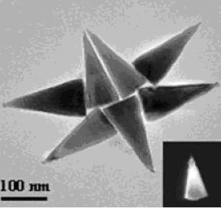
Properties of Semiconductor Materials and Chemicals
ZnO

Slide 33
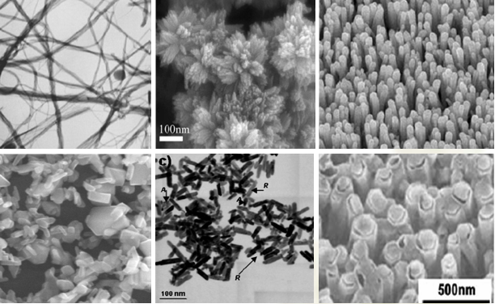
Properties of Semiconductor Materials and Chemicals
TiO₂

Slide 34
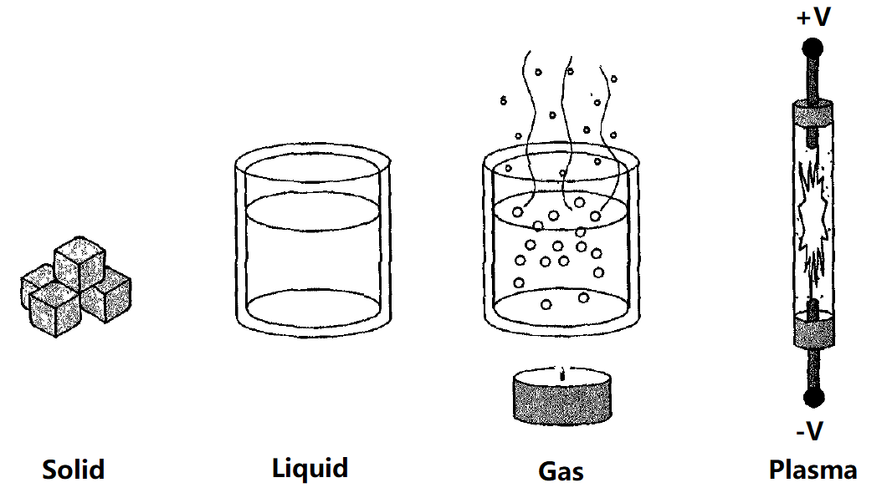
Properties of Semiconductor Materials and Chemicals
State of Matter
All matter in the universe exists in three basic states: solid, liquid, or gas. There is an additional fourth state that is not widely understood, known as plasma.

Slide 35
Properties of Semiconductor Materials and Chemicals
State of Matter
Plasma：A physical system consisting of neutrals, molecules, atoms, excited particles, ions, electrons and electromagnetic radiation.
Soild
冰
Liquid
水
Gas
水汽
Plasma
电离气体
0⁰C
100⁰C
10000⁰C
temperature

Slide 36
Properties of Semiconductor Materials and Chemicals
Temperature: a measure of whether one substance is hot or cold relative to another.
Silicon wafer manufacturing needs to deal with many situations at high temperature, such as heating to affect the chemical reaction or annealing the silicon single crystal structure to rearrange the atoms.
°F : developed by the German physicist Gabriel Fahrenheit with salt and aqueous solution. He set the freezing point of the salt solution at zero degrees Fahrenheit.
Generally, the freezing point temperature of pure water is more useful. In the Fahrenheit scale, the freezing point temperature of water is 32°F, the boiling point temperature is 212°F, and the difference between the two points is 180°F.
°C： it is more commonly used in scientific research. Set the freezing point of pure water to 0 °C and the boiling point to 100 °C.
K： it uses the same scale factor as the Celsius scale but is based on absolute zero. Absolute zero is the theoretical temperature at which all atoms stop moving, which is - 273 ° C.
Notes:
温度：是比较一个物质相对于另一个物质是热还是冷的量度。
硅晶圆制造中需要处理很多在高温下的情况，比如需要加热来影响化学反应（如改变化学反应速度）或者对硅单晶结构退火使原子重新排列。
华氏温标 (°F )：由德国物理学家Gabriel Fahrenheit用盐和水溶液开发的。他把盐溶液的冰点温度定为华氏零度。
一般地，纯水的冰点温度更有用，在华氏温标中水的冰点温度为32°F，沸点温度为212°F，两点之间相差180°F。
摄氏温标 (°C) ：在科学研究中更为常用，将纯水冰点设为 0°C，沸点设为100°C
开氏温标 (°K)：它和摄氏温标用一样的尺度，只不过是基于绝对零度。绝对零度就是所有原子停止运动的理论温度，该值为 -273°C。

Slide 37
Properties of Semiconductor Materials and Chemicals
Density is expressed as the weight in grams, per cubic centimeter of the material.
Specific gravity: a term used to reference the density of liquids and gases at 4℃. It is the ratio of the density of a substance compared to that of water. Gasoline has a specific gravity of 0.75, which means it is 75 percent as dense as water.
Vapor density: a density measurement of gases under certain conductions of temperature and pressure. The reference is air, with one 1cm3 having an assigned density of 1.
Pressures are expressed in pounds per square inch of area, in atmospheres or in torrs.
Vacuum: a term and condition encountered in semiconductor processing.
Notes:
比重：指4℃时液体和气体的密度。它是物质的密度与水的密度之比。汽油的比重为0.75，这意味着它的密度是水的75%。
蒸汽密度：在一定温度和压力下测量气体密度的方法。参考为空气，1cm3空气的指定密度为1。

Slide 38
Properties of Semiconductor Materials and Chemicals
Types and main uses of chemical reagents
Organic acids：RCOOH（羧酸）
Inorganic acids：
Acids
H₂SO₄
H₃PO₄
HNO₃
HCl
HF
organic alkalis ：TMAH （氢氧化四甲基铵）
Inorganic alkalis ：
Alkalis
NaOH
KOH
NH₄OH
DI water
C₃H₈O（异丙醇）
C₂HCl₃（三氯乙烯）
CH₃COCH₃（丙酮）
Solvents
Cleaning agent

Slide 39
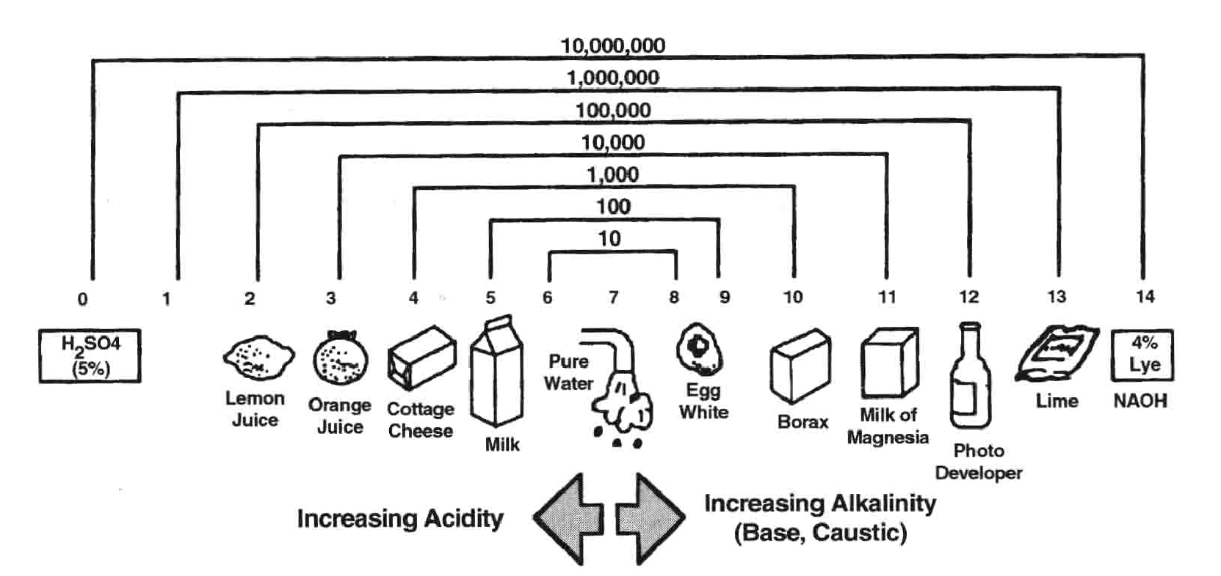
Properties of Semiconductor Materials and Chemicals
Hydrogen ion concentration： the ratio between the total number of hydrogen ions and the total amount of substances in the solution, which is generally referred to as “pH” .
Notes:
是指溶液中氢离子的总数和总物质的量的比，一般称为“pH”

